Slide 1
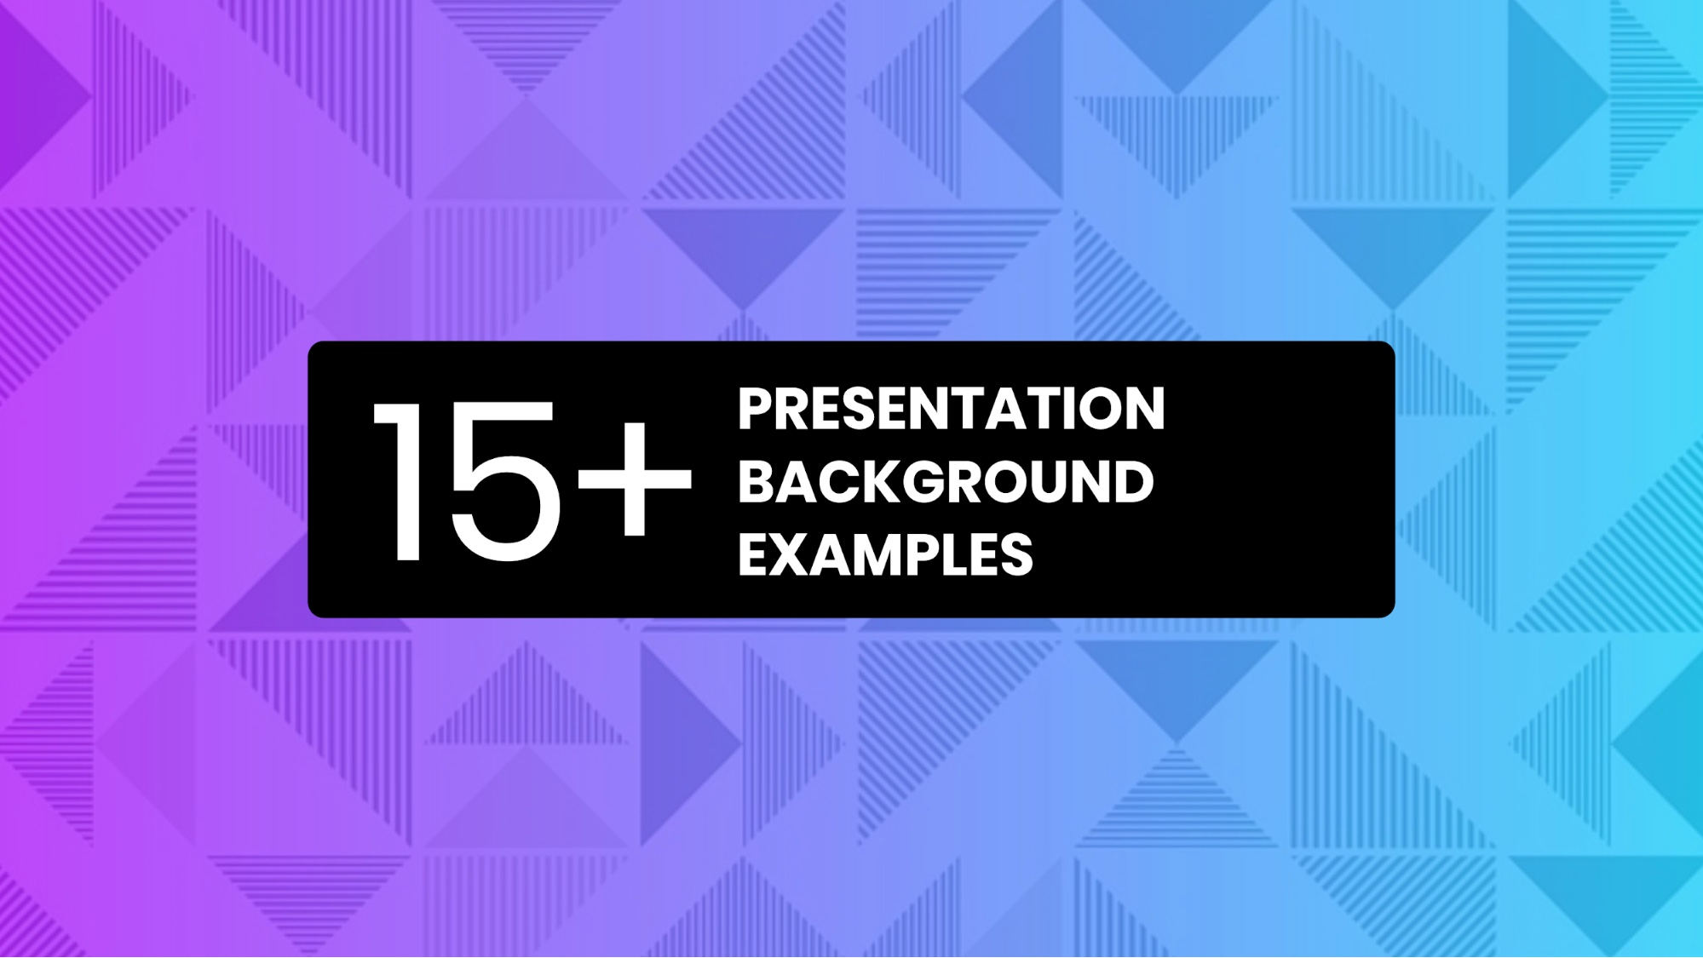

Needs of Mobile OS
Presented by: Nishchal Acharya

Slide 2

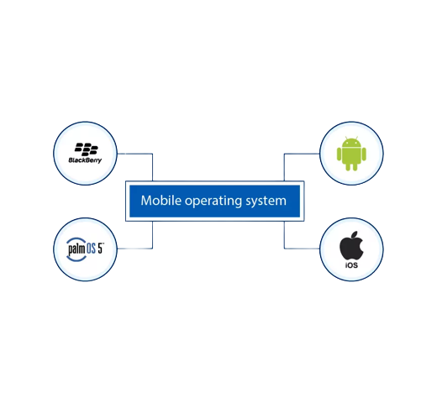
INTRODUCTION TO MOBILE OS
A mobile operating system (OS) is software that allows smartphones, tablets and other
devices to run applications and programs. A mobile OS provides an interface between
the device's hardware components and its software functions. It typically starts when a
device powers on, presenting a screen with icons or tiles that show information and
provide application access. Mobile operating systems also manage cellular and wireless
network connectivity and phone access.

Slide 3
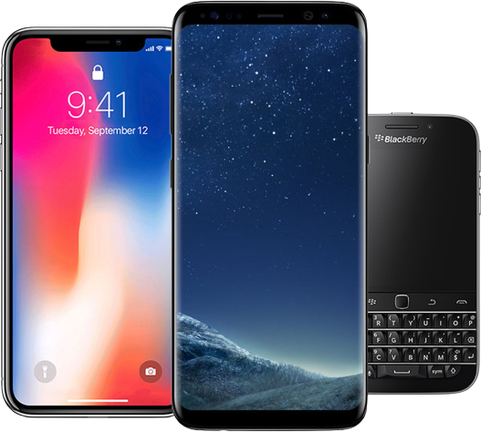
TYPES OF MOBILE OPERATIONG SYSTEM
Some common mobile OS are as follows:
1. Android
2. Apple OS (IOS)
3. Windows Mobile OS
4. Blackberry OS
MOBILE OPERATIONG SYSTEM

Slide 4

Android OS
The Android operating system is a mobile operating system that was developed by Google
(GOOGL​) to be primarily used for touchscreen devices, cell phones, and tablets. Its design
lets users manipulate the mobile devices naturally, with finger movements that mirror
common motions, such as pinching, swiping, and tapping. Google also employs Android
software in televisions, cars, and wristwatches—each of which is fitted with a unique user
interface.
Android Operating System

Slide 5
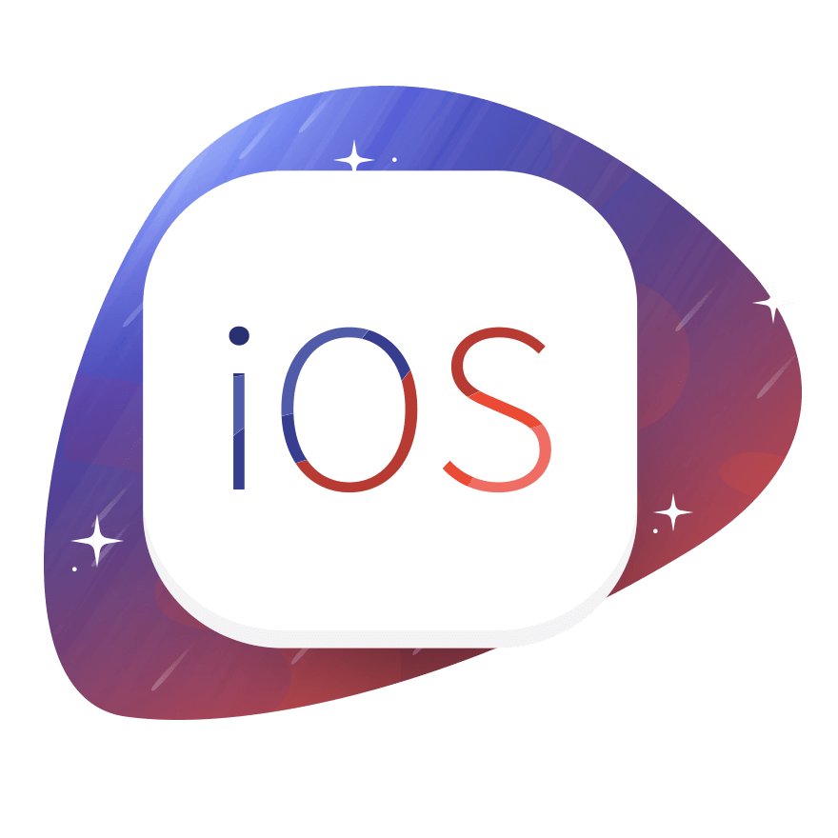
IOS ( iPhone Operating System )
Apple iOS is the second-most popular mobile operating system. As of June 2021, Apple iOS
held a 26.3 percent share of the mobile phone market, second only to Android which held
a 73.3 percent market share. The first version of iOS was released in June 2007, when the
iPhone debuted on the market. iOS, an acronym for iPhone Operating System, is a
Unix-derived operating system powering all of Apple’s mobile devices. The name iOS was
not officially applied to the software until 2008, when Apple released the iPhone software
development kit (SDK), enabling any app makers to create applications for the platform.
iPhone Operating System

Slide 6
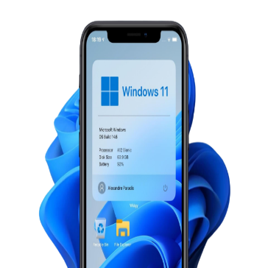
Windows Operating System
Windows Phone is a proprietary mobile operating system developed by Microsoft. Windows
Phone introduced a new design language, previously called Metro UI, but later renamed to
simply Modern. Microsoft licenses the software to third-party hardware manufacturers,
but keeps a stringent list of minimum requirements for the hardware it runs on to ensure
the best user experience. In 2011 Nokia announced it has chosen Windows Phone as the OS
for all its future smartphones providing a solid backing for the fledgling OS and in the same
time betting all of its mobile phone business on its success.
Windows Operating System

Slide 7
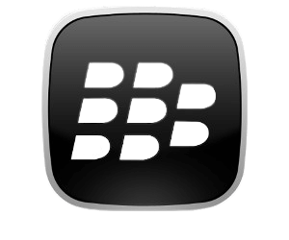
Blackberry OS
The BlackBerry OS is designed for smartphone environments and is best known for its robust
support for push Internet email. This push email functionality is carried out through the
dedicated BlackBerry Enterprise Server (BES), which has versions for Microsoft Exchange,
Lotus Domino and Novell GroupWise. Other mobile operating systems like Android, Microsoft
Windows Mobile and Symbian can run on different brands of mobile phones; the BlackBerry
OS can run only on BlackBerry phones. BlackBerry OS is similar to Apple’s iOS in this regard.
Blackberry Operating System

Slide 8
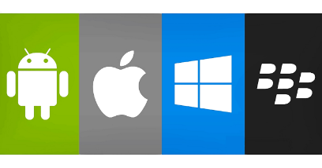
Why OS is Needed to Run Our Mobile Device ?
Operating systems (OS) on mobile devices play a crucial role in ensuring seamless functionality
and user experience. These OSs serve as the digital backbone, managing hardware resources,
providing security, and enabling the installation and execution of applications. Without a robust
and efficient mobile OS, smartphones and tablets would be nothing more than expensive
paperweights. Mobile OSs also facilitate constant updates and improvements, enhancing device
performance and adding new features. Furthermore, they offer a user-friendly interface, making
it easy for individuals to navigate their devices, access information, and communicate with others.
In essence, mobile OSs are the foundation upon which the modern mobile computing experience is
built, enabling us to stay connected, productive, and entertained on the go.
Mobile Phone Operating System

Slide 9
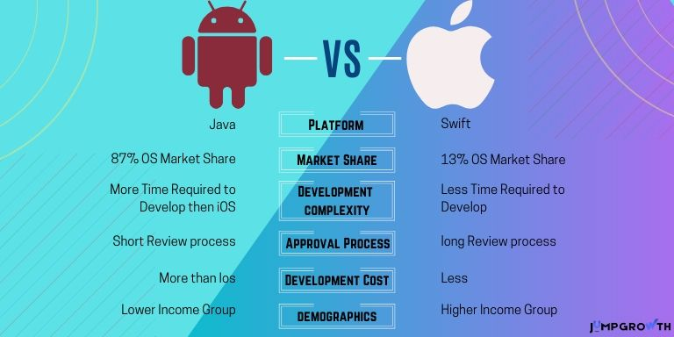
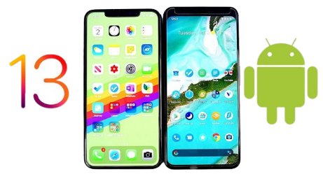
Comparison Between Android and IOS

Slide 10
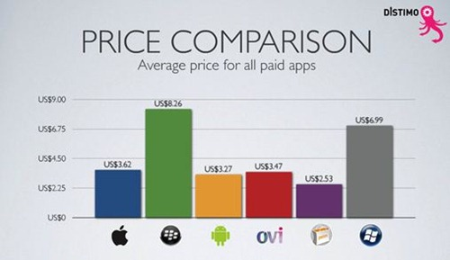
Price Comparison Between Different OS

Slide 11

Thanks a Lot To Provide Me This Golden Opportunity
Thank you for taking the time to watch my presentation.
Your attention and support are greatly appreciated. If
you have any questions or feedback, please feel free to
reach out. Thanks again for being a part of this presentation!

